Slide 1
JS-functionalities

Slide 2
Contents
JS can change HTML contents, attributes, css, elements
Output
Functions
Objects
Condition
Loops
Finding HTML Elements

Slide 3
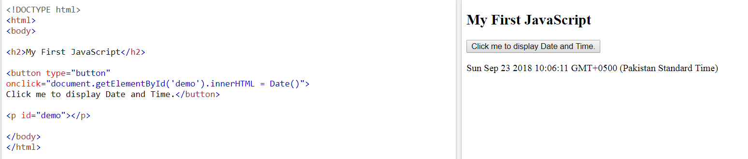

Slide 4
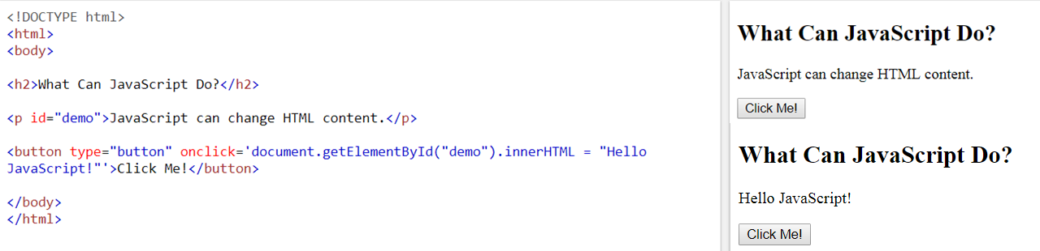
JavaScript Can Change HTML Content
One of many JavaScript HTML methods is getElementById().
This example uses the method to "find" an HTML element (with id="demo") and changes the element content (innerHTML) to "Hello JavaScript":

Slide 5
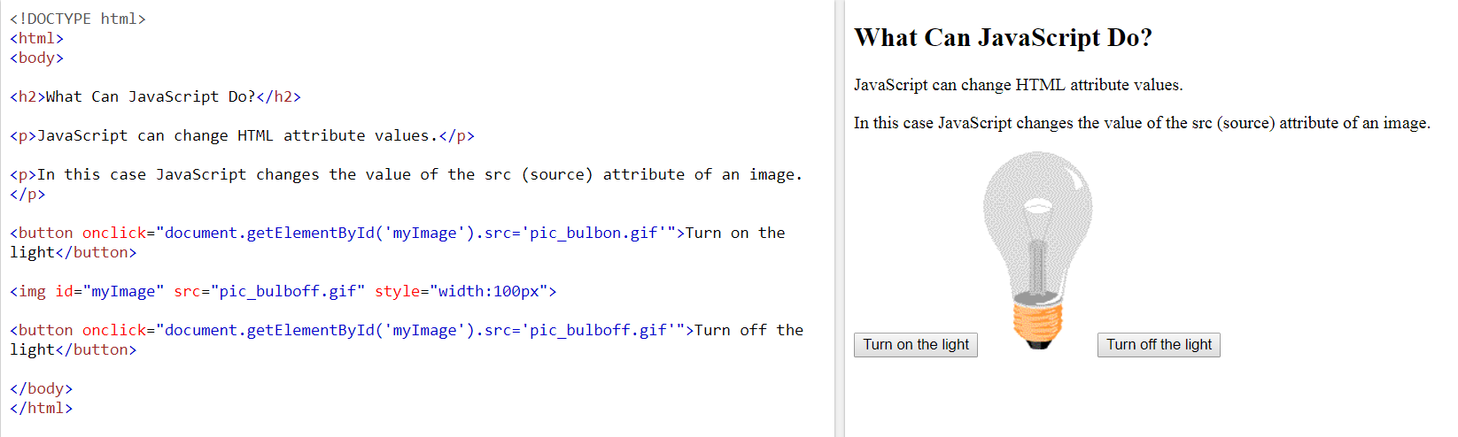
JavaScript Can Change HTML Attribute Values
Notes:
In this example JavaScript changes the value of the src (source) attribute of an <img> tag.

Slide 6
JavaScript Can Change HTML Styles (CSS)
Notes:
Changing the style of an HTML element, is a variant of changing an HTML attribute

Slide 7
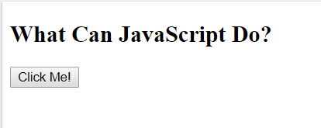
JavaScript Can Hide HTML Elements
Notes:
Hiding HTML elements can be done by changing the display style:

Slide 8
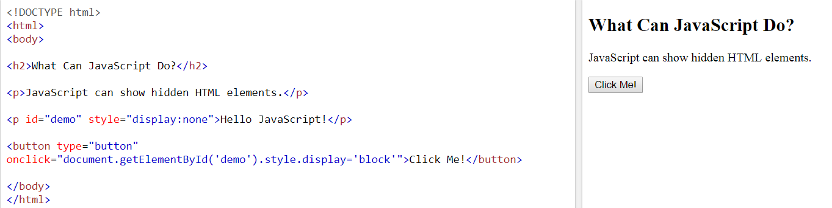
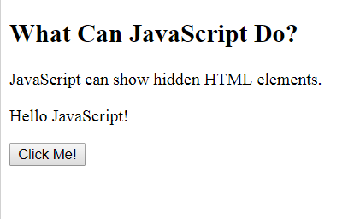
JavaScript Can Show HTML Elements

Slide 9
Output
JavaScript can "display" data in different ways:
Writing into an HTML element, using innerHTML.
Writing into the HTML output using document.write().
Writing into an alert box, using window.alert().
Writing into the browser console, using console.log().

Slide 10
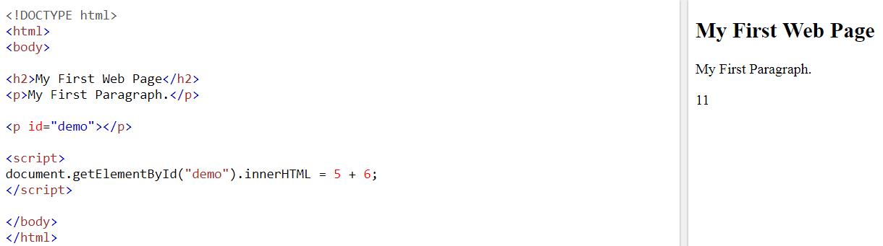
Using InnerHTML
To access an HTML element, JavaScript can use the document.getElementById(id) method.
The id attribute defines the HTML element. The innerHTML property defines the HTML content.

Slide 11
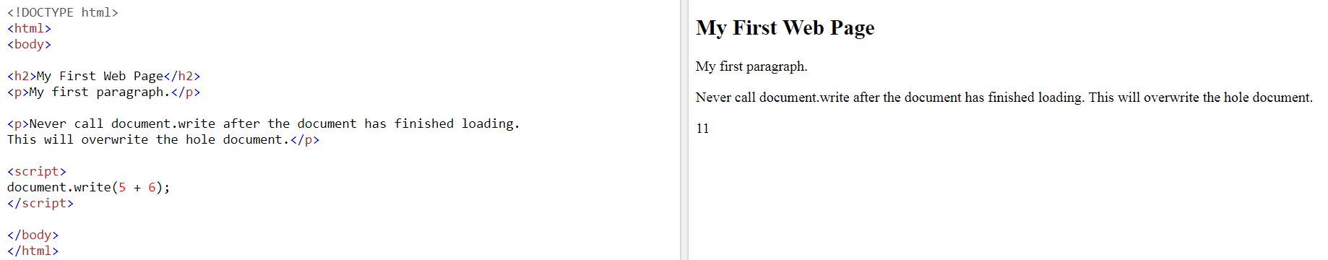
Using document.write()
For testing purposes, it is convenient to use document.write():
Notes:
Using document.write() after an HTML document is loaded, will delete all existing HTML:
Example:
<!DOCTYPE html> <html> <body> <h1>My First Web Page</h1> <p>My first paragraph.</p> <button type="button" onclick="document.write(5 + 6)">Try it</button> </body> </html>

Slide 12
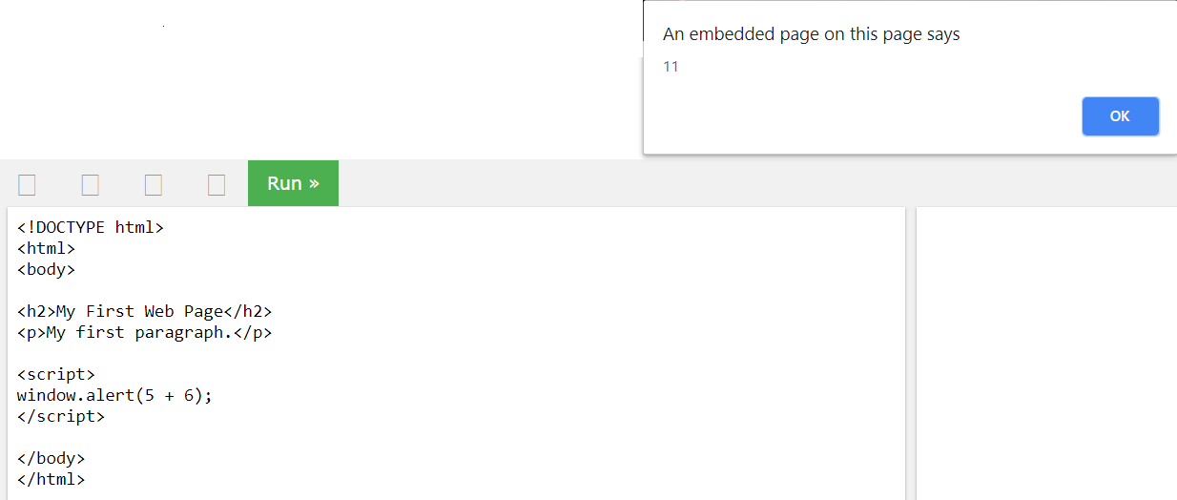
Using window.alert()

Slide 13
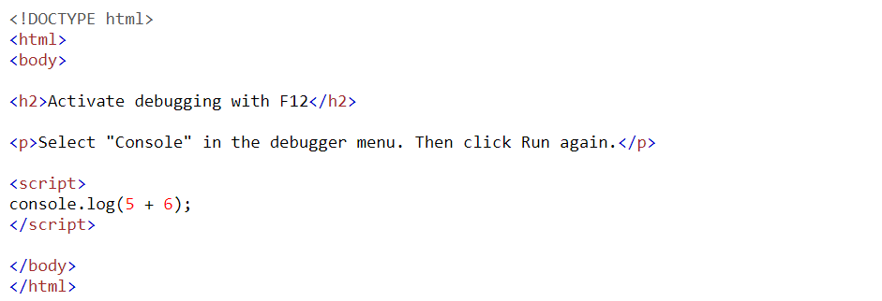
Using console.log()
For debugging purposes, you can use the console.log() method to display data.

Slide 14
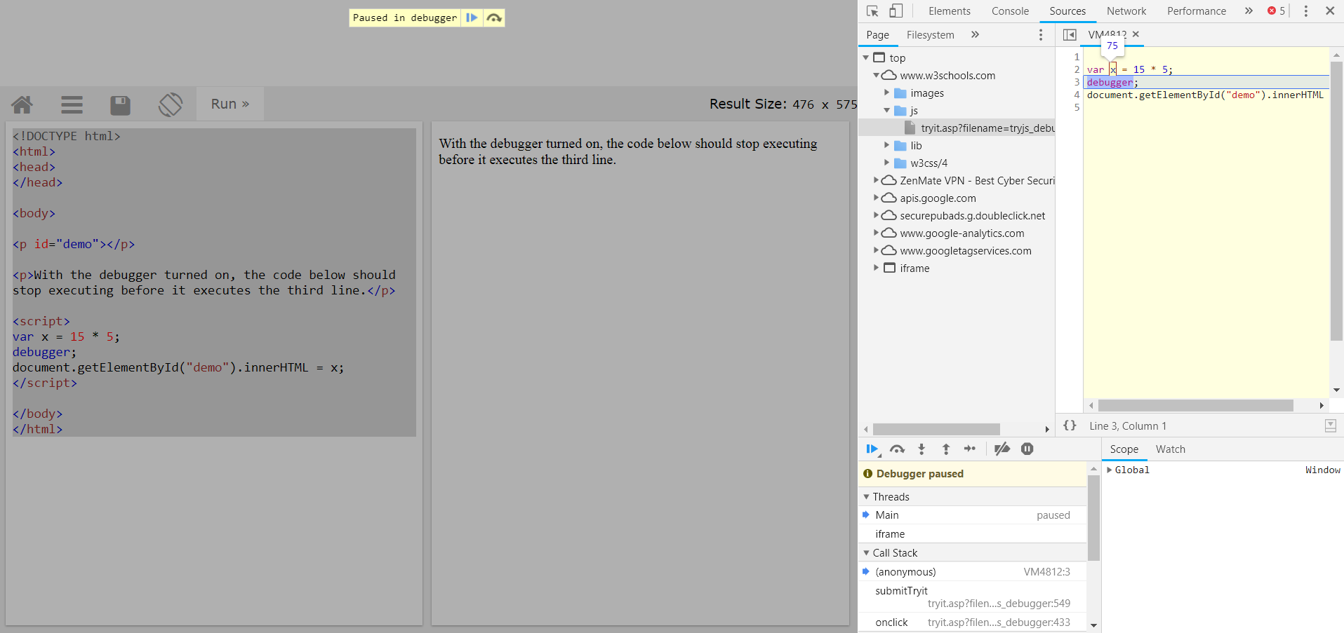
Debugging

Slide 15
Functions
A JavaScript function is a block of code designed to perform a particular task.
A JavaScript function is executed when "something" invokes it (calls it)
JavaScript Function Syntax
function name(parameter1, parameter2, parameter3) { code to be executed }
Function Invocation (The code inside the function will execute when "something" invokes (calls) the function):
When an event occurs (when a user clicks a button)
When it is invoked (called) from JavaScript code
Automatically (self invoked)
Notes:
arguments.length (The arguments.length property returns the number of arguments received by the functions)

Slide 16
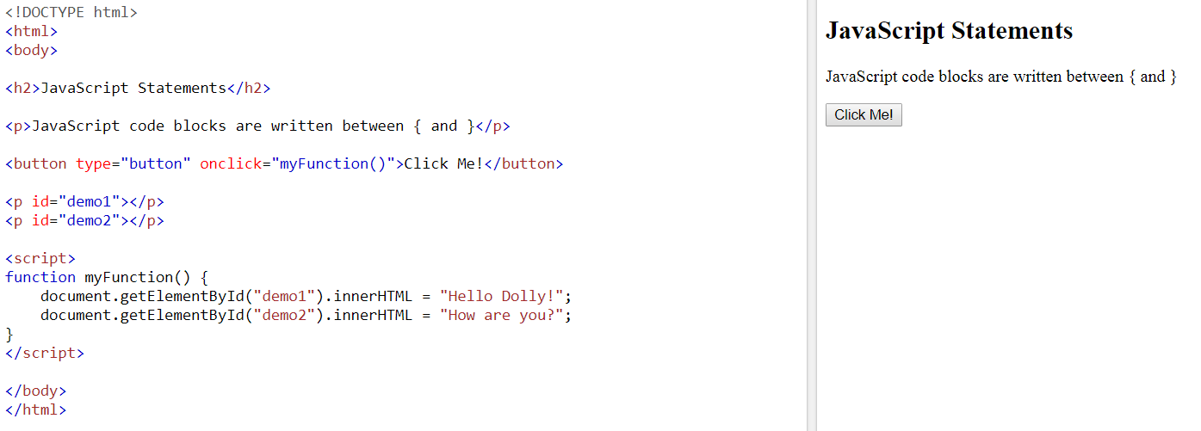
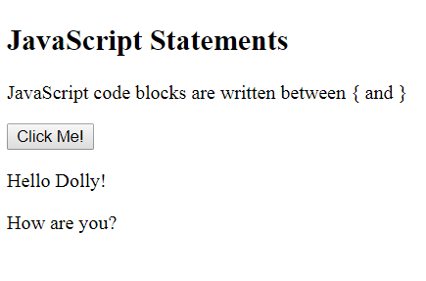
Functions - When an event occurs (when a user clicks a button)

Slide 17
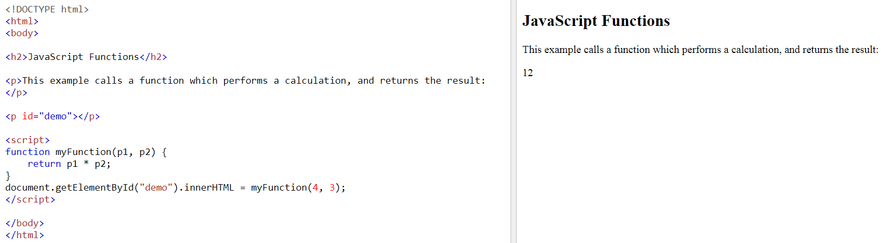
Functions - When it is invoked (called) from JavaScript code

Slide 18
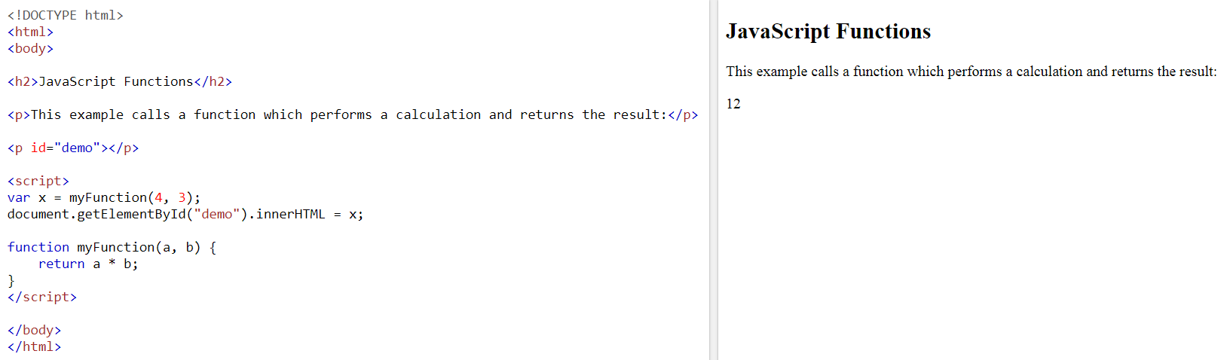
Contd.
Notes:
Another way of calling function

Slide 19
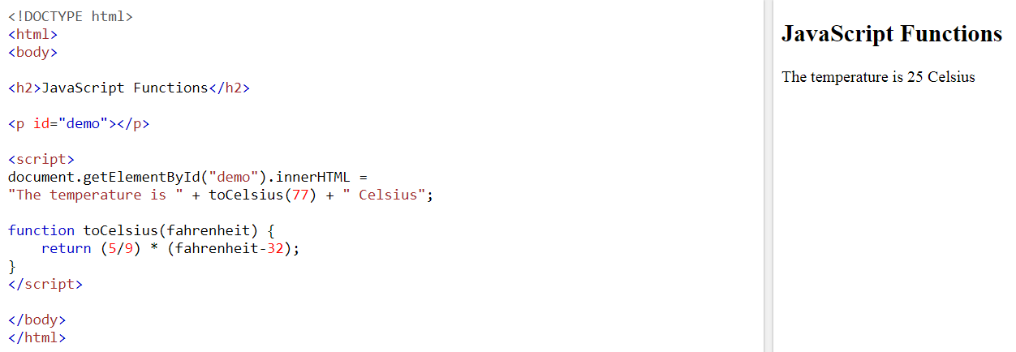
Functions Used as Variable Values

Slide 20
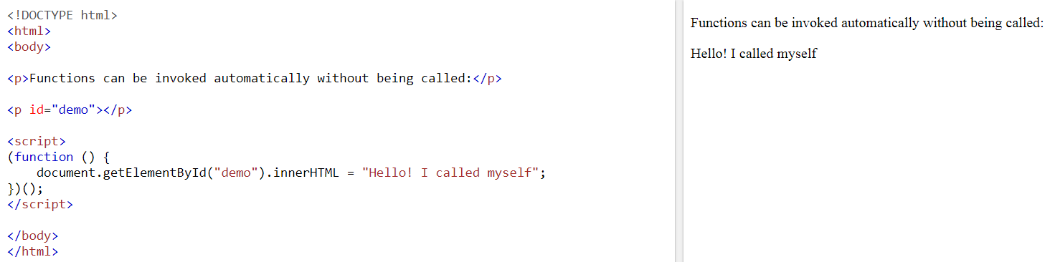
Functions - Automatically (self invoked)

Slide 21
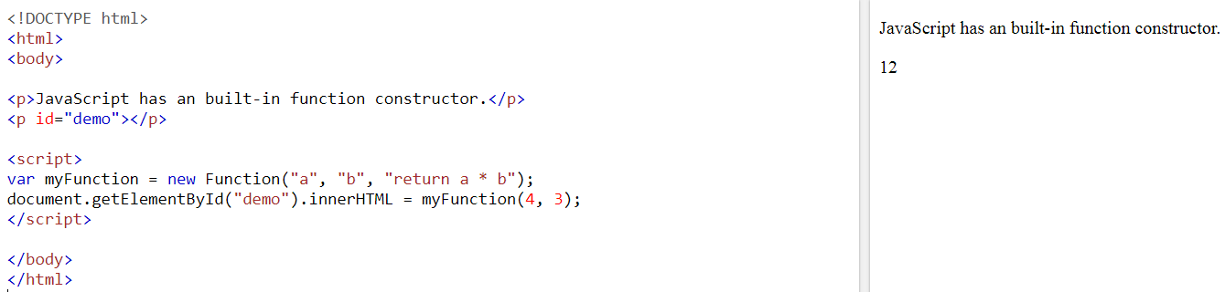
JavaScript has an built-in function constructor

Slide 22
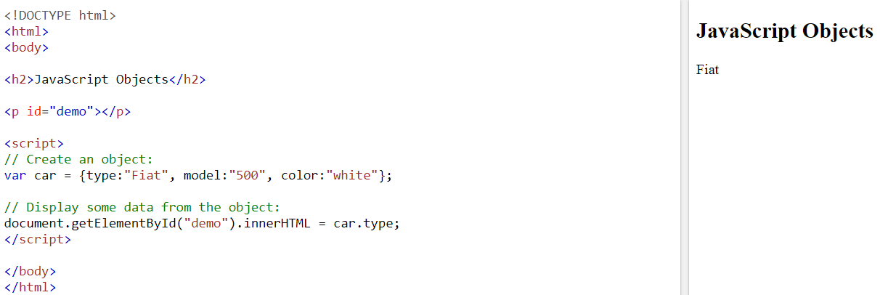
Objects - declaration
Notes:
This keyword can also be used.

Slide 23
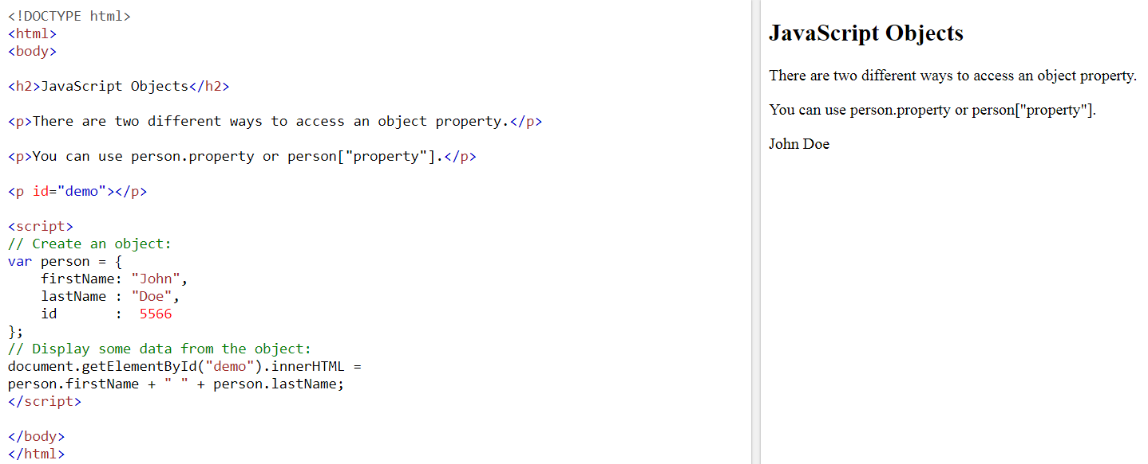
Accessing Object Properties
There are two different ways to access an object property.You can use person.property or person["property"]

Slide 24
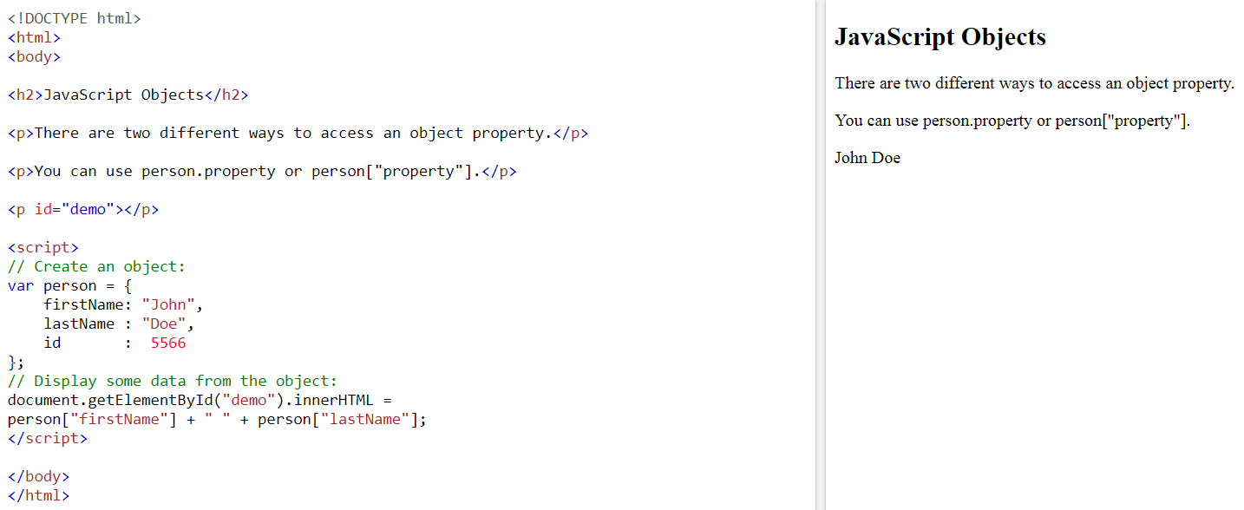
Contd.

Slide 25
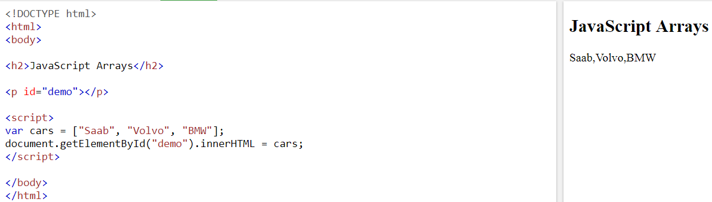
Arrays
Declaring (Method-1):

Slide 26
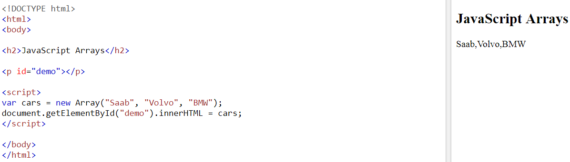
Declaring (Method-2):

Slide 27
Accessing JavaScript Arrays
JavaScript array elements are accessed using numeric indexes (starting from 0)
<script>
var cars = ["Saab", "Volvo", "BMW"];
document.getElementById("demo").innerHTML = cars[0];
</script>
Accessing all array elements
<script>
var cars = ["Saab", "Volvo", "BMW"];
document.getElementById("demo").innerHTML = cars;
</script>

Slide 28
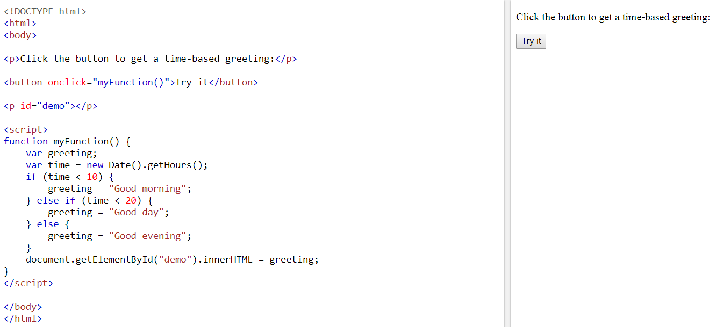
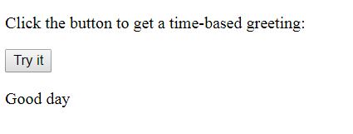
Conditions (if/else)

Slide 29
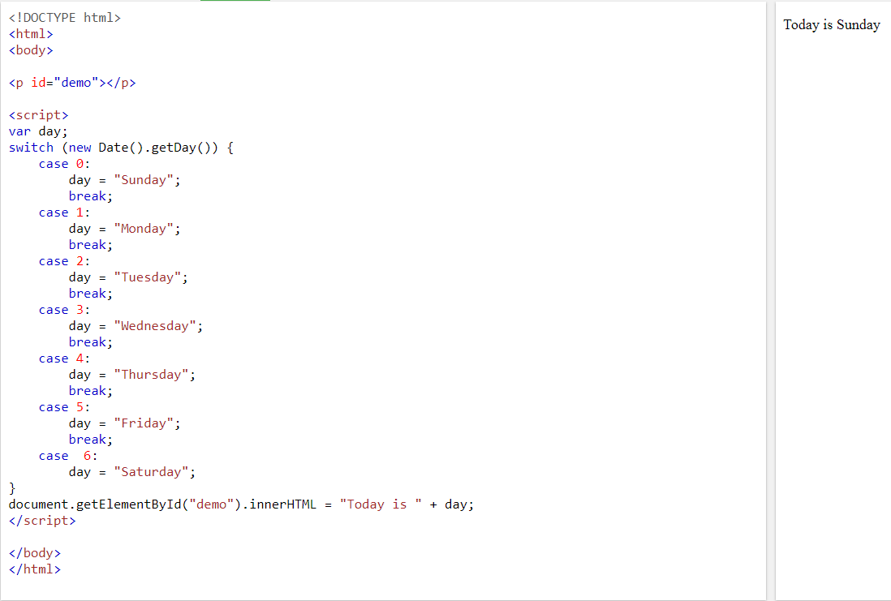
Switch Cases

Slide 30
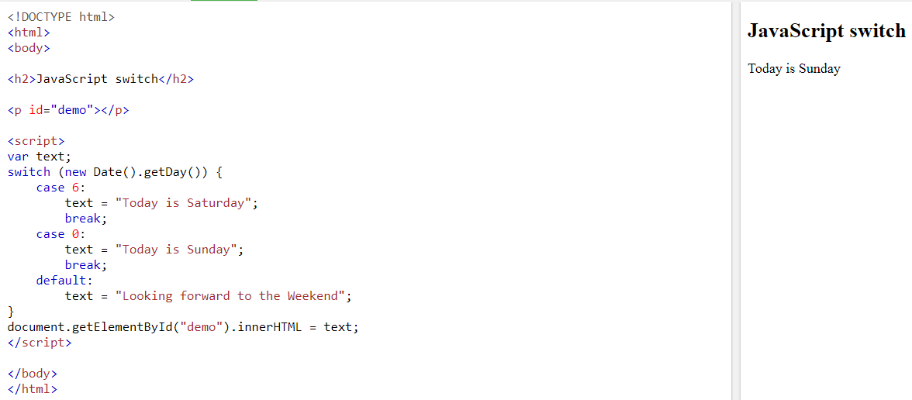
Contd.
Notes:
For default condition

Slide 31
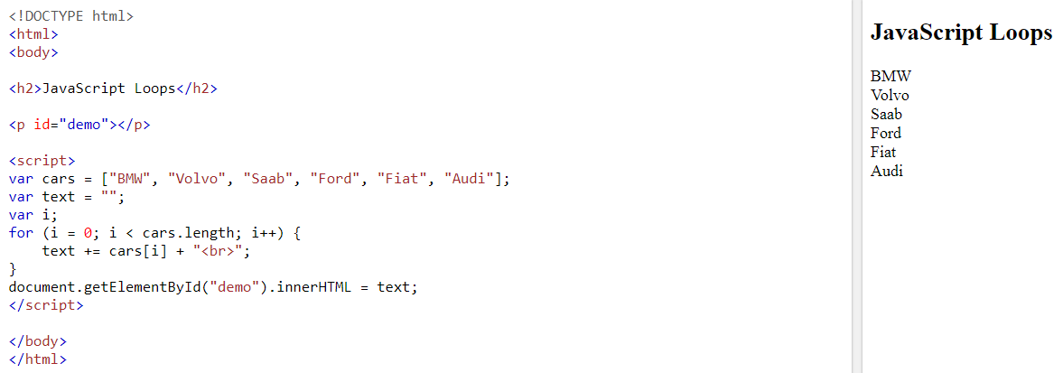
JS – for loop

Slide 32
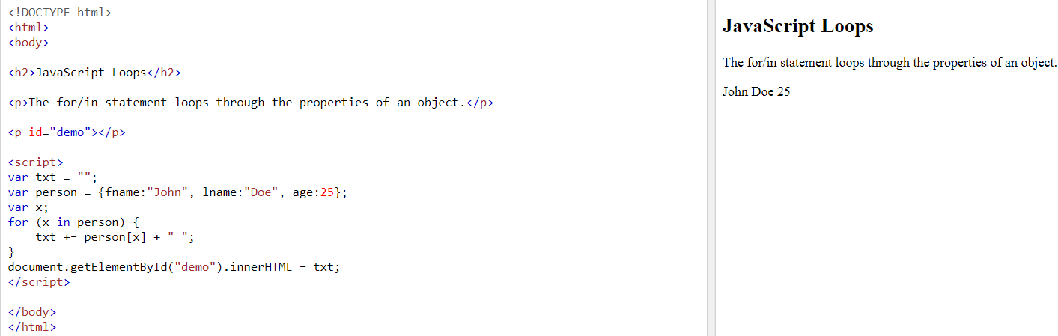
JS - For/In Loop

Slide 33
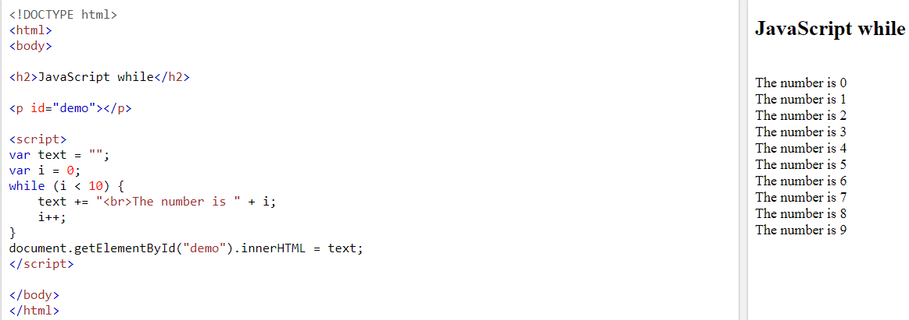
JS – while loop

Slide 34
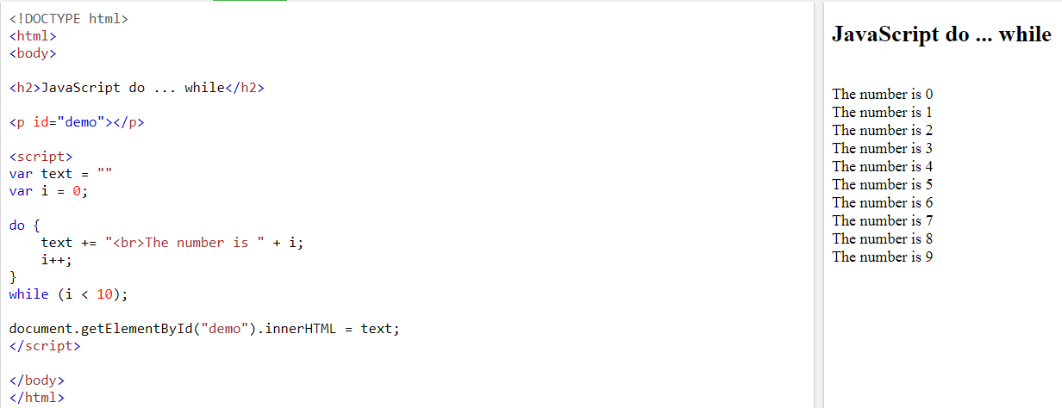
JS – do while loop

Slide 35
Finding HTML Elements
Often, with JavaScript, you want to manipulate HTML elements. To do so, you have to find the elements first. There are a couple of ways to do this:
Finding HTML elements by id
Finding HTML elements by tag name
Finding HTML elements by class name
Finding HTML elements by CSS selectors

Slide 36
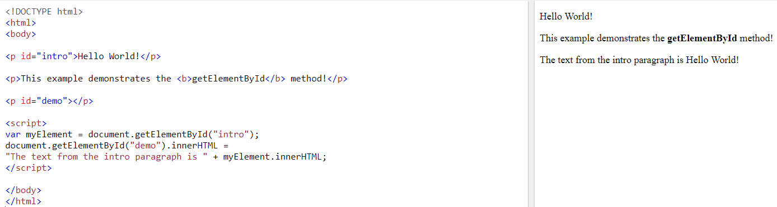
Finding HTML Element by Id

Slide 37
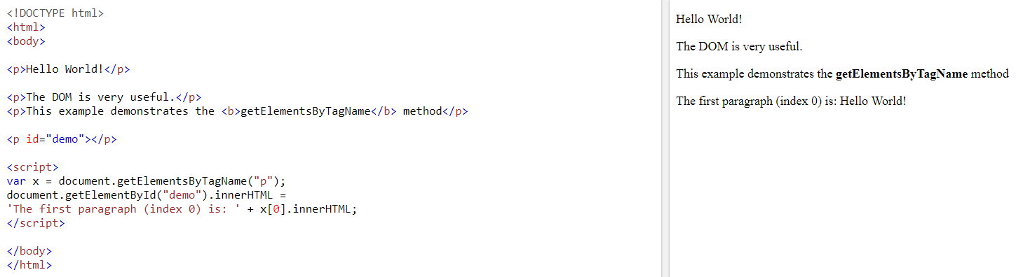
Finding HTML elements by tag name

Slide 38
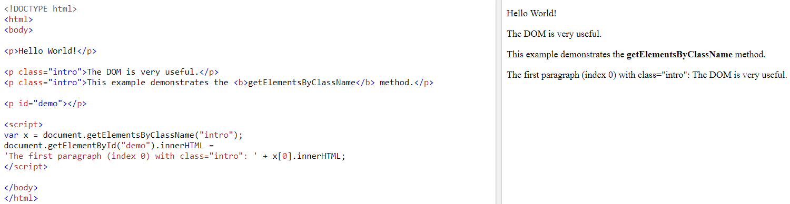
Finding HTML elements by class name

Slide 39
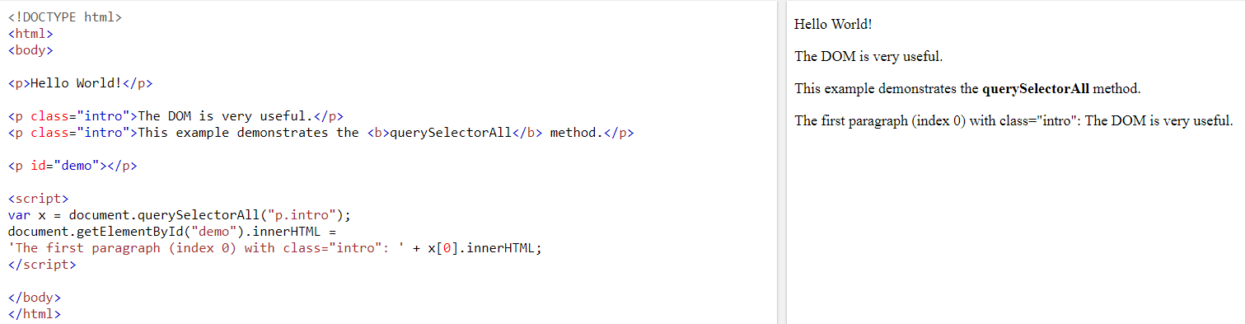
Finding HTML elements by CSS selectors

Slide 40
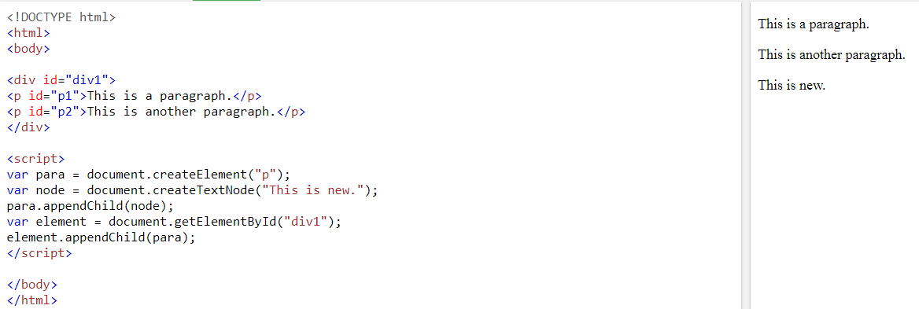
JavaScript HTML DOM Elements (Nodes) - Creating New HTML Elements (Nodes)

Slide 41
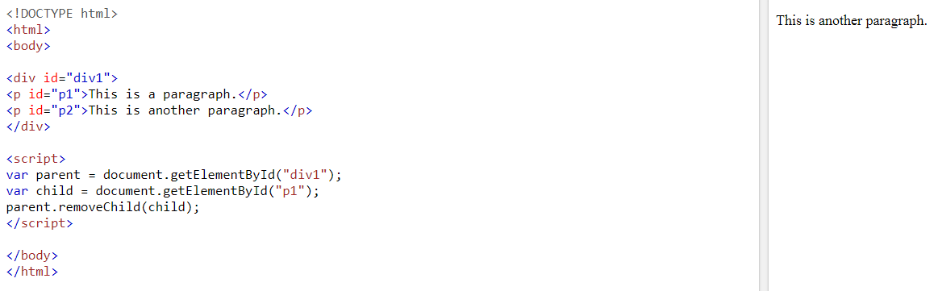
Removing Existing HTML Elements

Slide 42
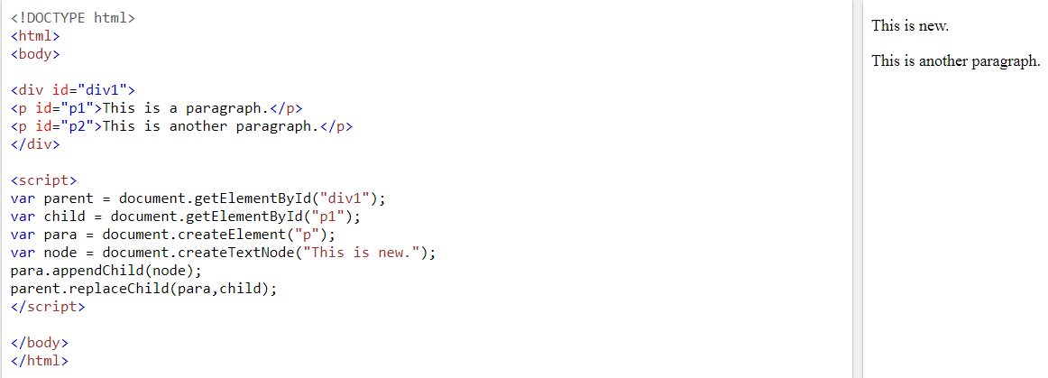
Replacing HTML Elements

